Slide 1
Education vs. Infant Mortality Rate
Alexandra Stock
Jasmine Pattany
Jennifer Barroso
Sebastian Echeverri

Slide 2





Who are we?
Intro
Data Exploration
Data Cleanup
Data Analysis
Graphs
Conclusions

Slide 3

Background
Intro
Data Exploration
Data Cleanup
Data Analysis
Graphs
Conclusions
JAMS will be looking at data that shows how education of a population shows a change in child mortality rates over time

Slide 4

Hypothesis
Intro
Data Exploration
Data Cleanup
Data Analysis
Graphs
Conclusions
JAMS expected that countries who provide more resources for education (as a result a more educated population) will provide more family planning, therefore infant mortality rates would be lower
Graphs using world data should show correlations between high education levels and low infant mortality rates

Slide 5










Data Sources
Intro
Data Exploration
Data Cleanup
Data Analysis
Graphs
Conclusions
Data Sources: UNICEF, OECD
Tools (Methods): Pandas, Matplotlib, Python (Jupyter Notebook)

Slide 6
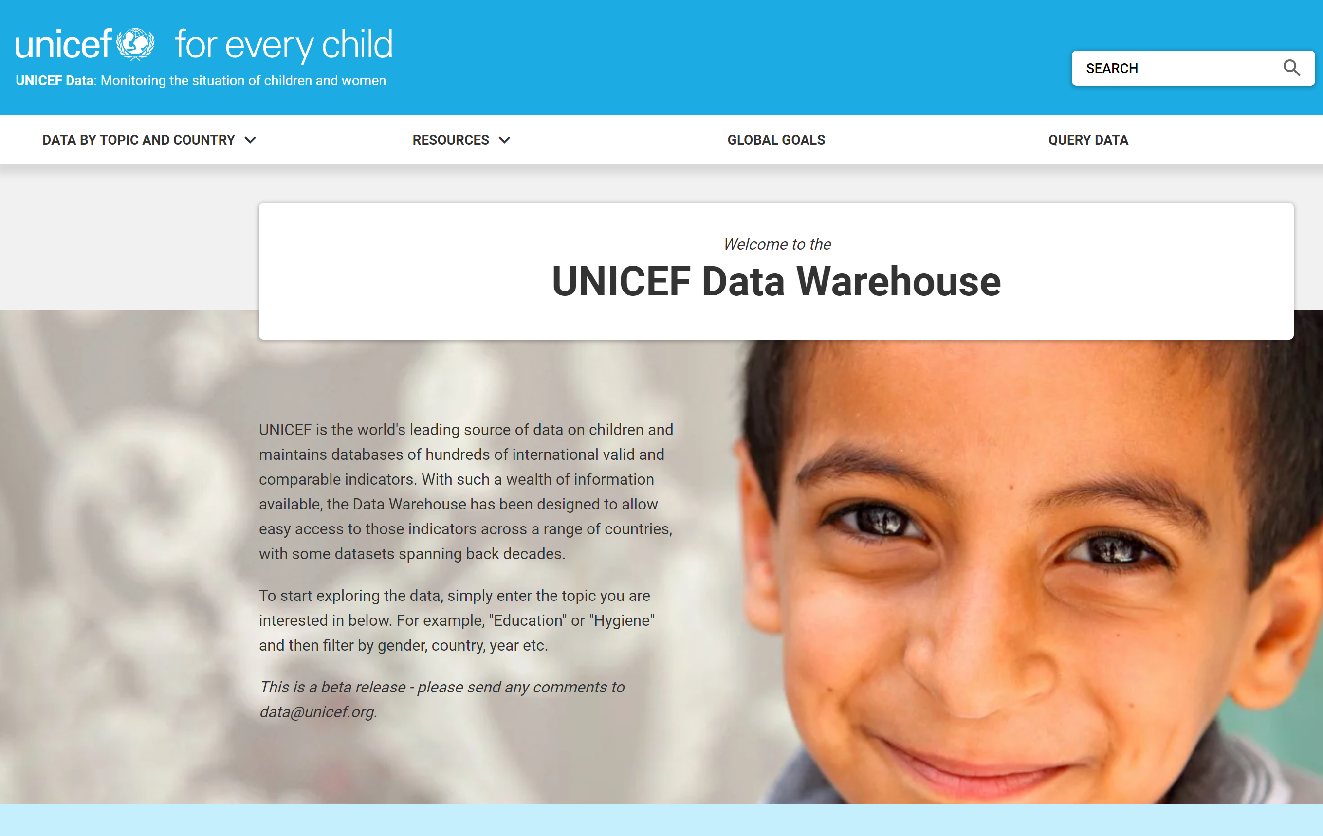
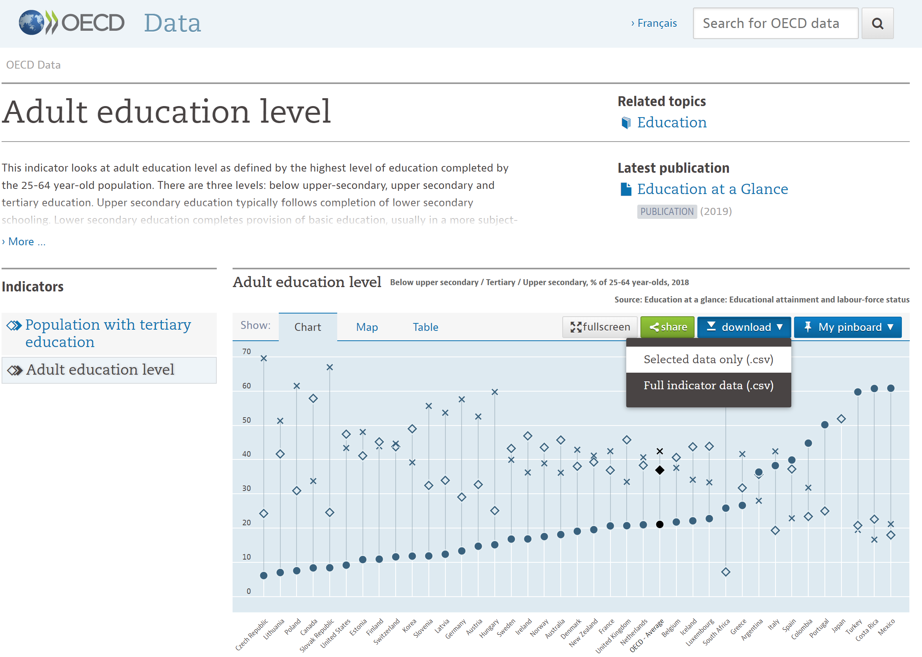
Data Sources
Intro
Data Exploration
Data Cleanup
Data Analysis
Graphs
Conclusions
UNICEF – Infant Mortality Information
OECD- Adult Education Levels
Infant deaths per 1,000 live births
This indicator looks at adult education level as defined by the highest level of education completed by the 25 - 64 year old population (%)

Slide 7
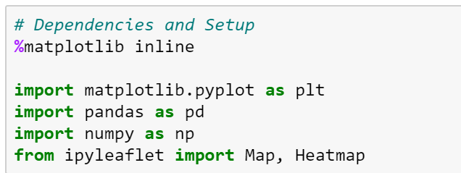
Imports
Intro
Data Exploration
Data Cleanup
Data Analysis
Graphs
Conclusions
Imported to display the figures
Imported to create graphs and figures
Imported to use for data manipulation and analysis
Imported to work with arrays – did not end up using numpy
Imported to create a heatmap

Slide 8
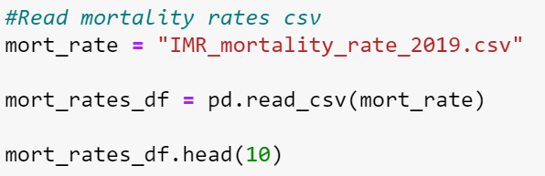
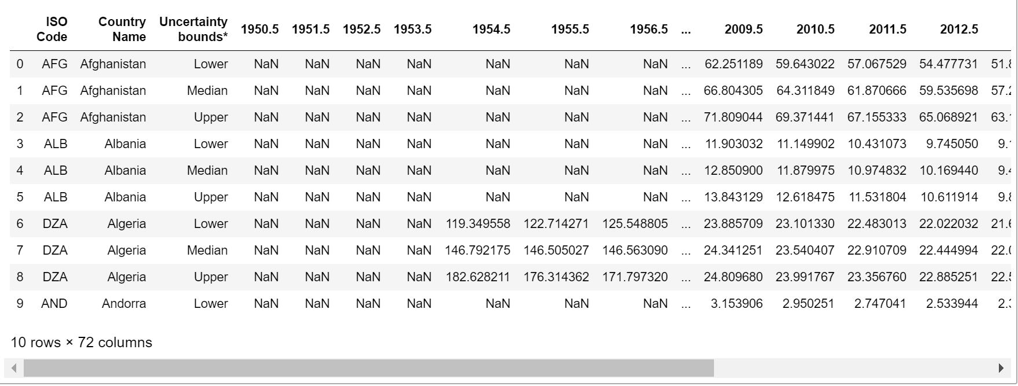
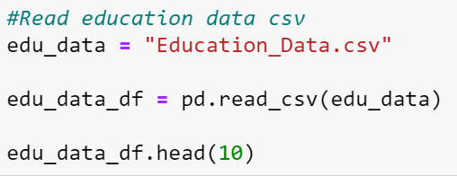
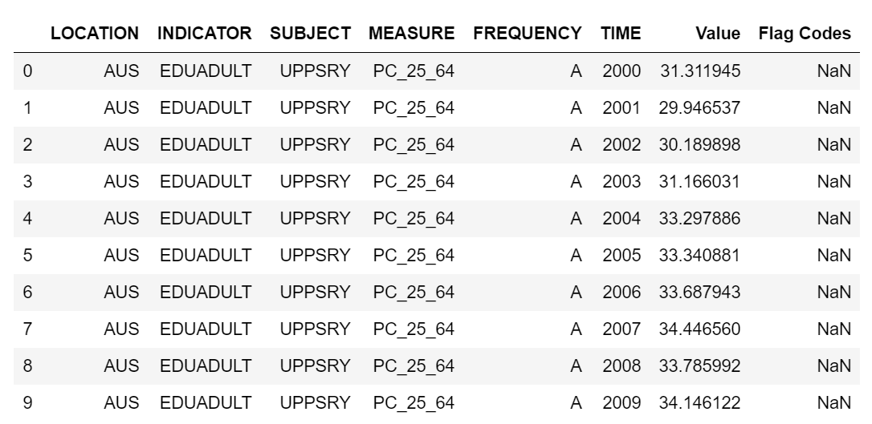
Read CSV’s
Intro
Data Exploration
Data Cleanup
Data Analysis
Graphs
Conclusions
Steps:
Make the csv equal to a variable
Read csv using variable name
Print

Slide 9
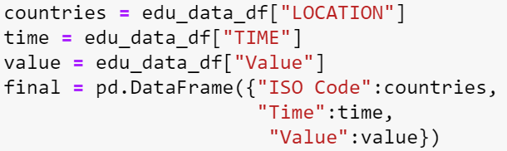
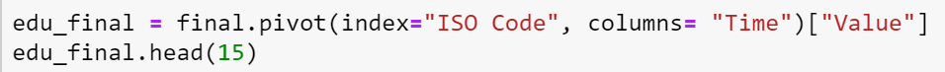
Education Data
Intro
Data Exploration
Data Cleanup
Data Analysis
Graphs
Conclusions
Assigning columns a name
Using them to create a DataFrame
Using pivot to assign the index and move the ‘Time’ to columns

Slide 10
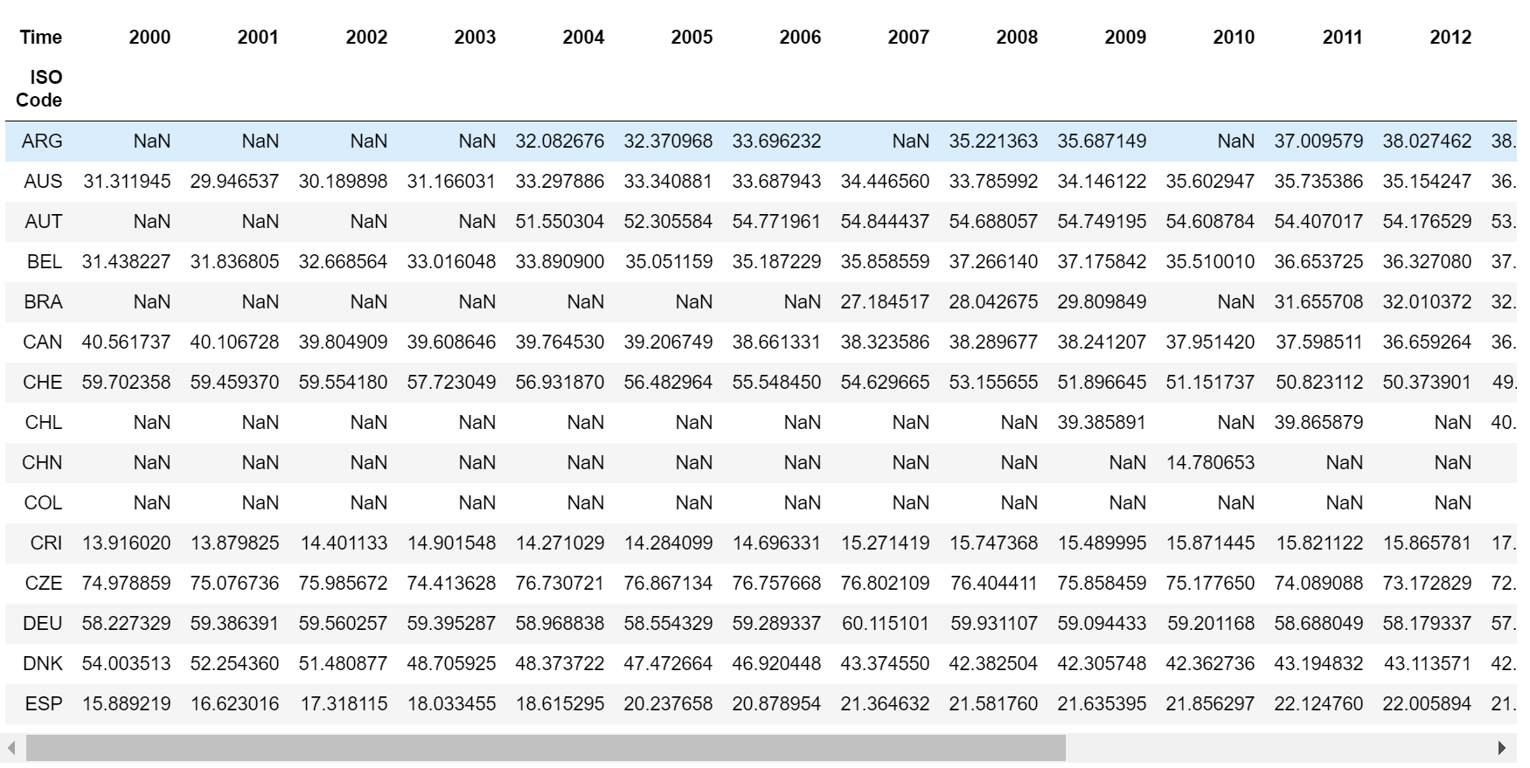
Education Data
Intro
Data Exploration
Data Cleanup
Data Analysis
Graphs
Conclusions

Slide 11
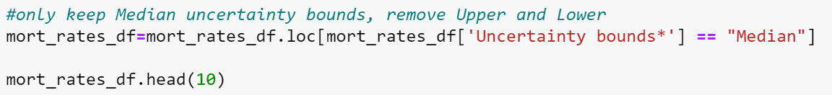
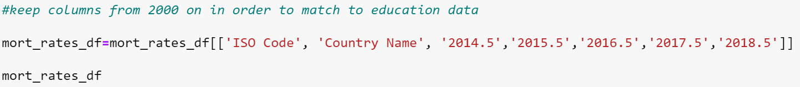
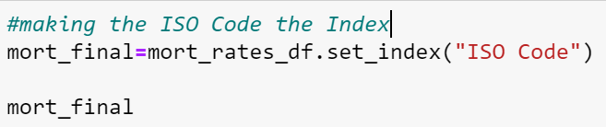
Infant Mortality Data
Intro
Data Exploration
Data Cleanup
Data Analysis
Graphs
Conclusions
Removing Upper and Lower uncertainty bounds only keeping Median
Data for this CSV was from 1950-2018.
Education CSV had less data so only columns that would be used were called
Setting the ISO Code as the index and printing the DataFrame

Slide 12
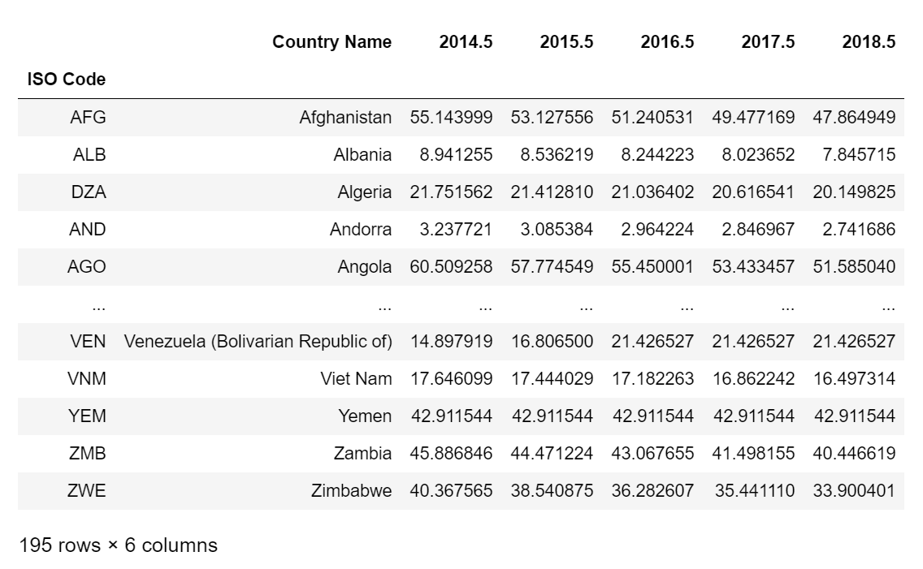
Infant Mortality Data
Intro
Data Exploration
Data Cleanup
Data Analysis
Graphs
Conclusions

Slide 13
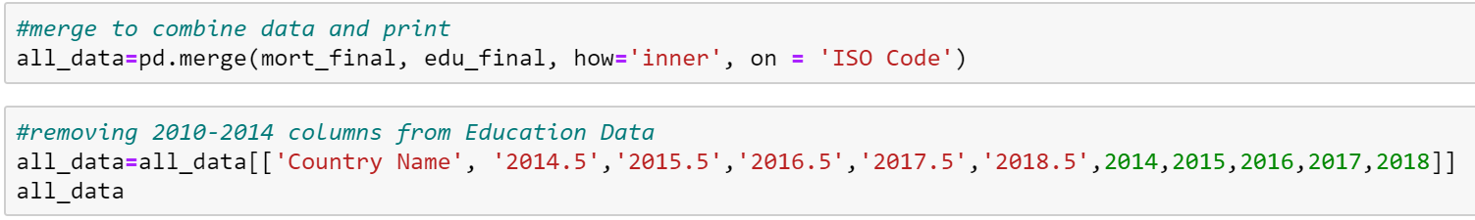
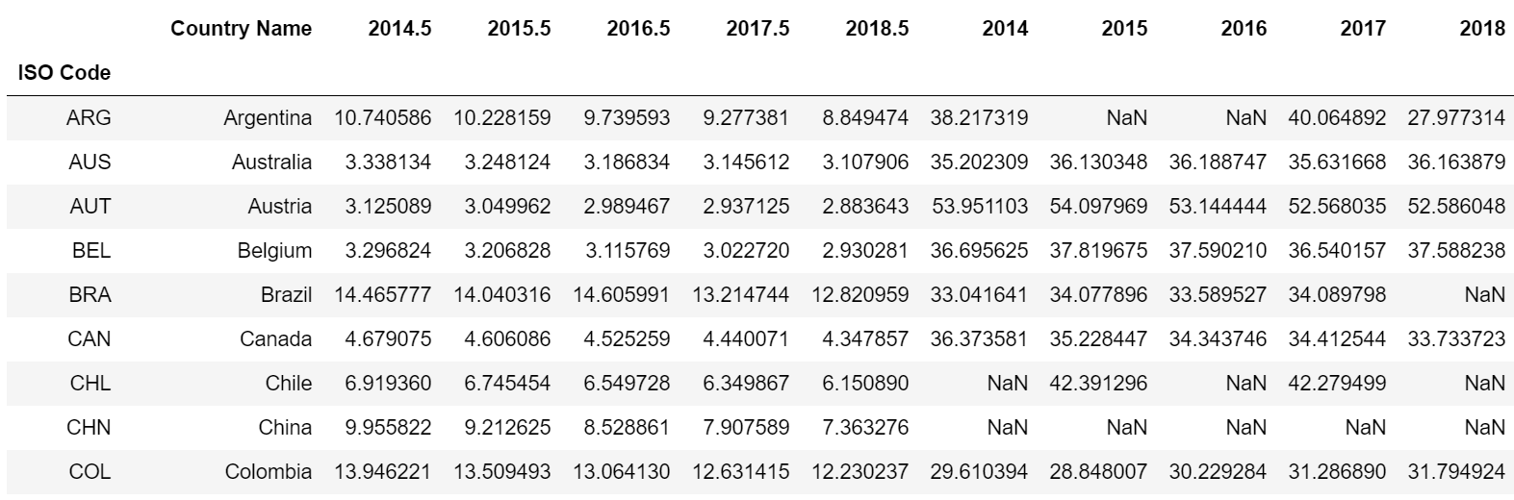
Merge
Intro
Data Exploration
Data Cleanup
Data Analysis
Graphs
Conclusions

Slide 14
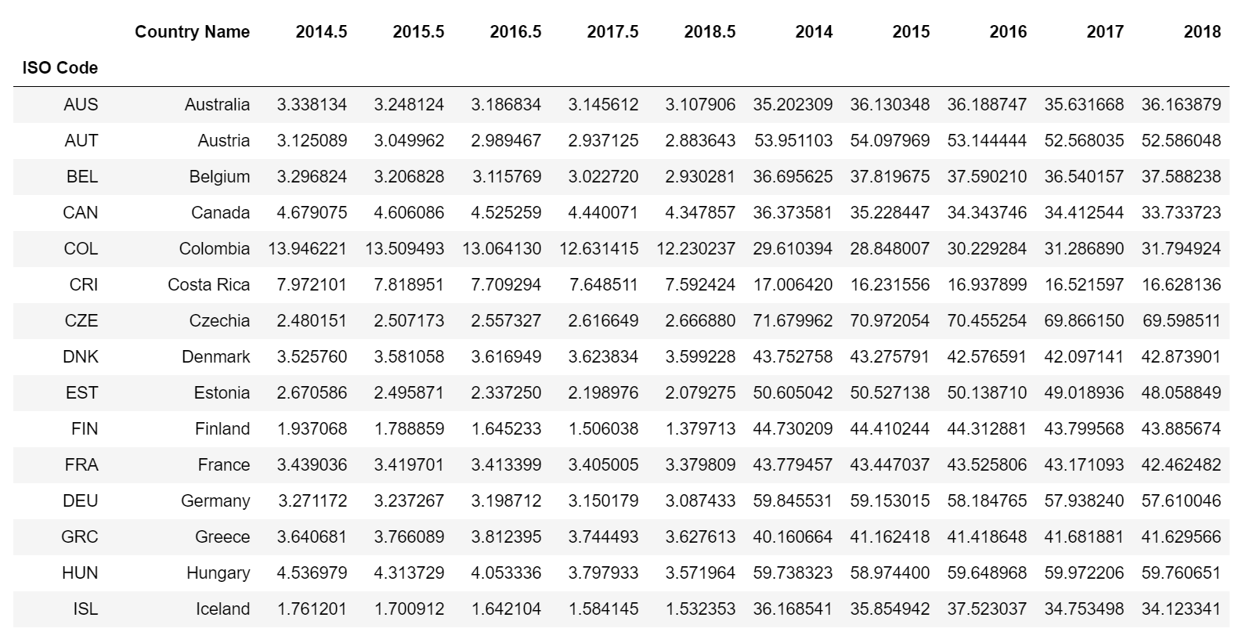
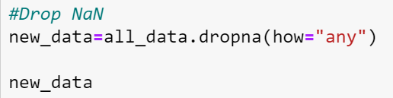
Drop NaN
Intro
Data Exploration
Data Cleanup
Data Analysis
Graphs
Conclusions
To remove the NaN Values
Printing DataFrame without NaN

Slide 15
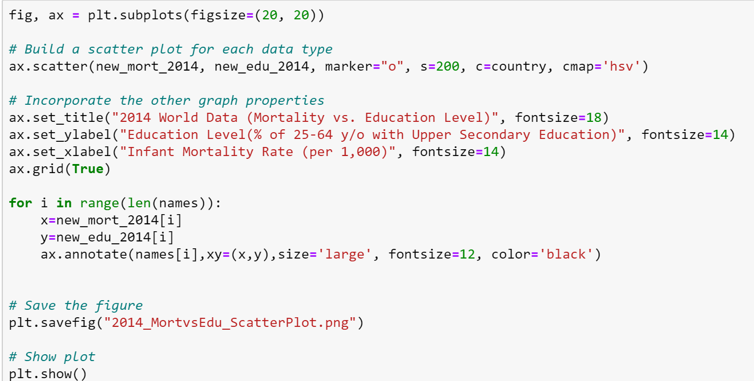
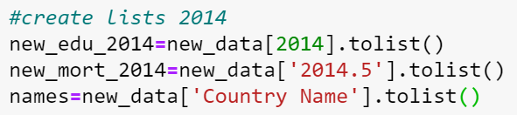
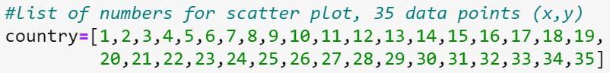
Creating a Scatter Plot
Intro
Data Exploration
Data Cleanup
Data Analysis
Graphs
Conclusions

Slide 16
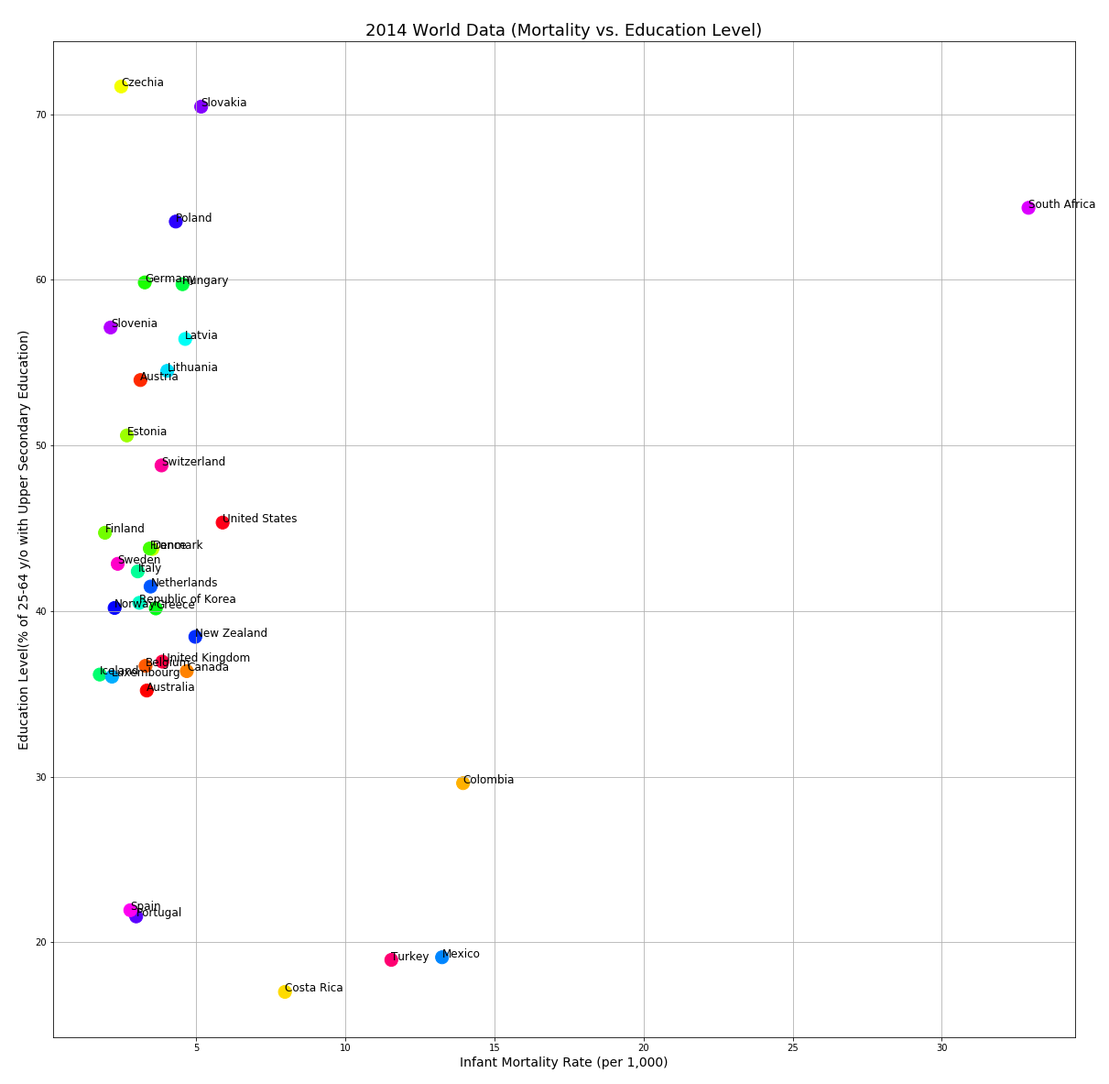
Intro
Data Exploration
Data Cleanup
Data Analysis
Graphs
Conclusions

Slide 17
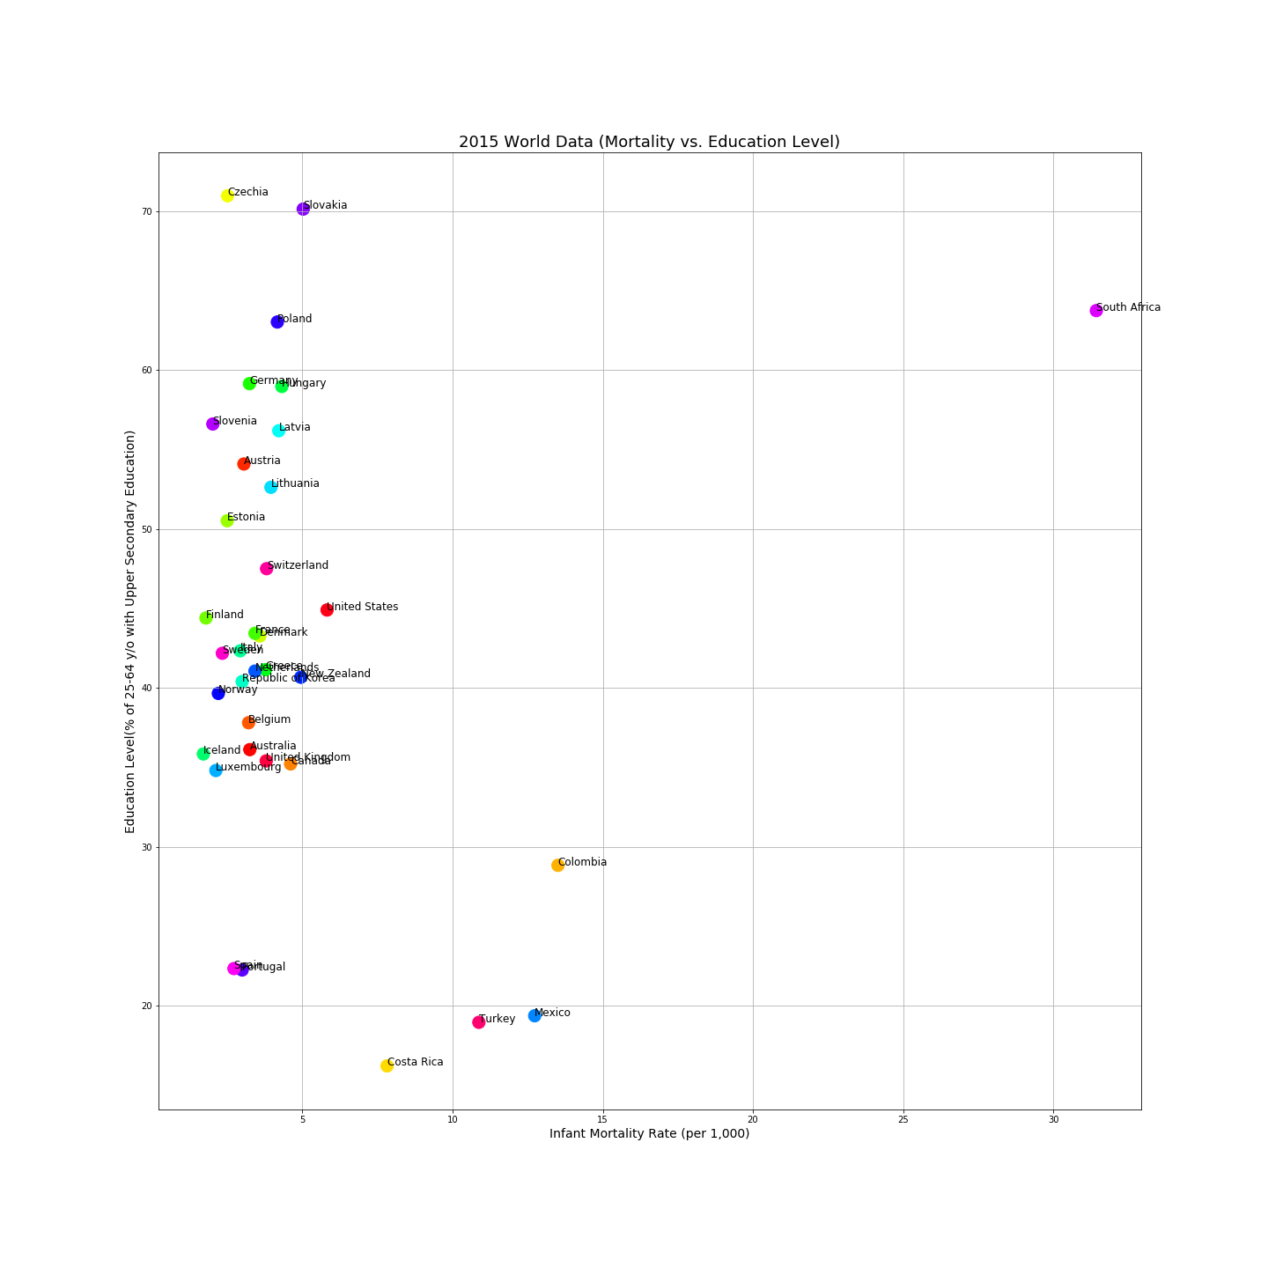
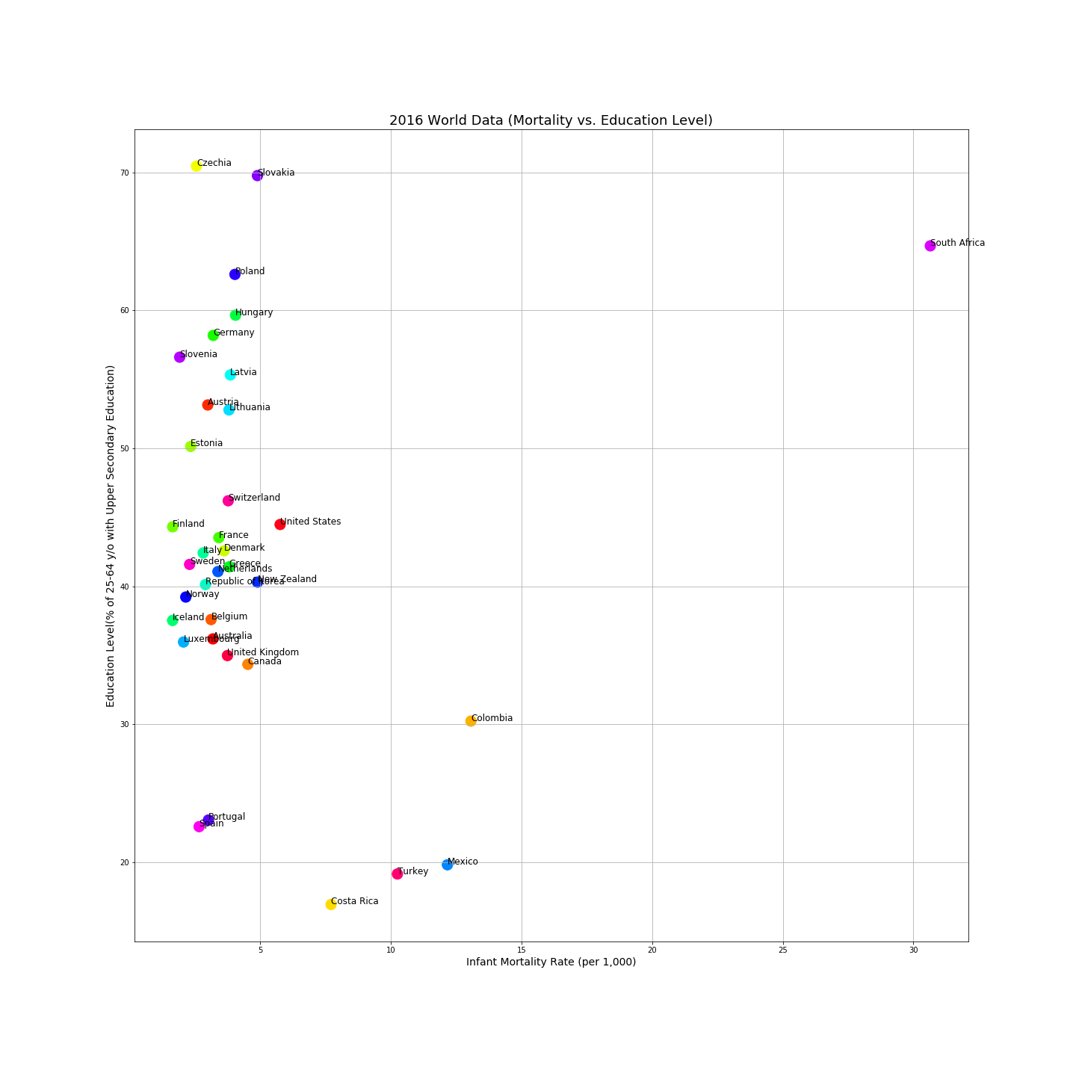
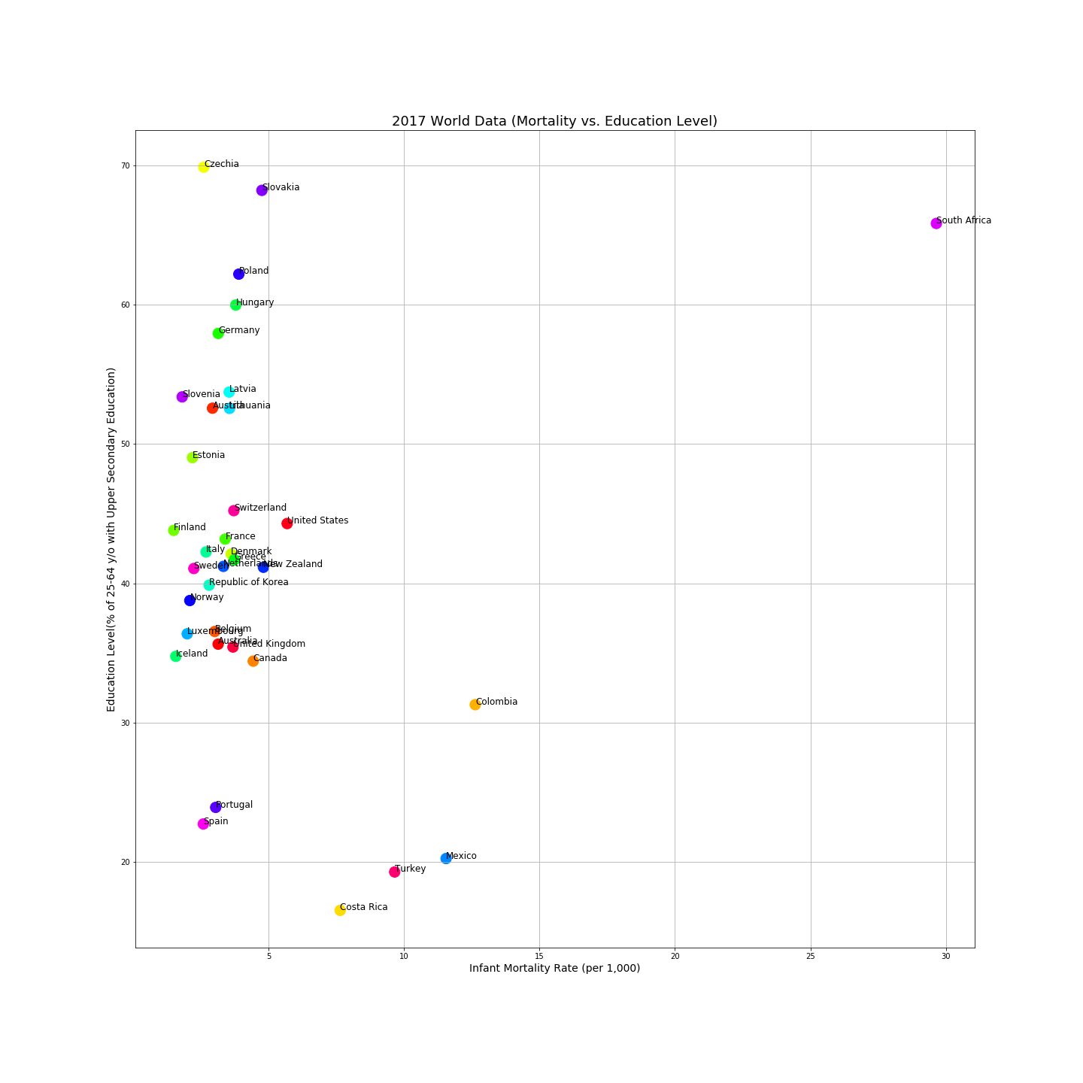
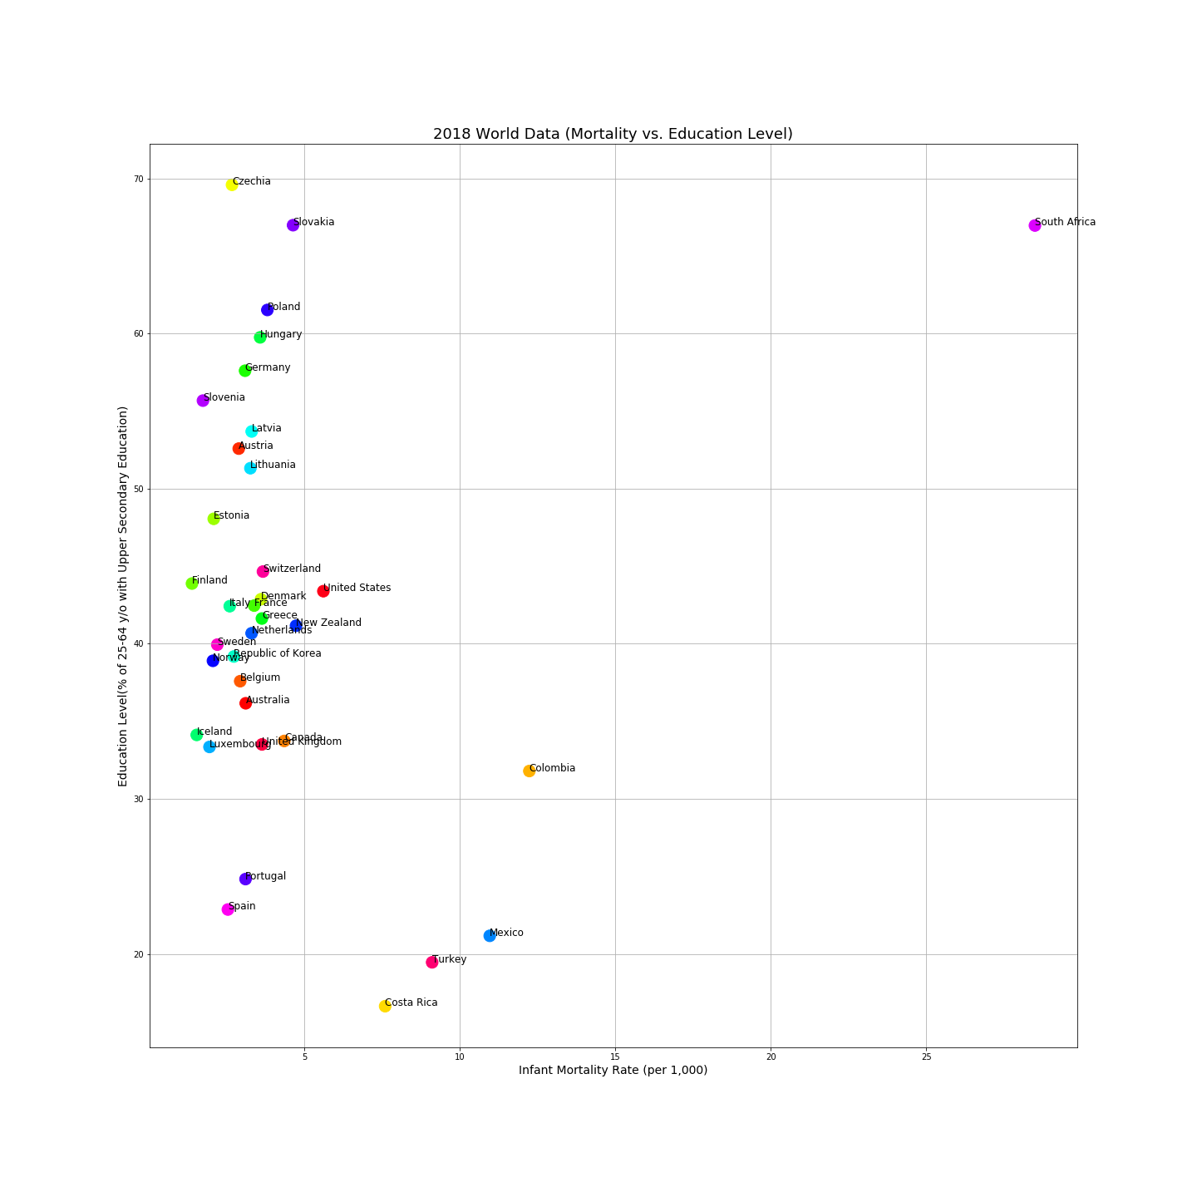
Intro
Data Exploration
Data Cleanup
Data Analysis
Graphs
Conclusions

Slide 18
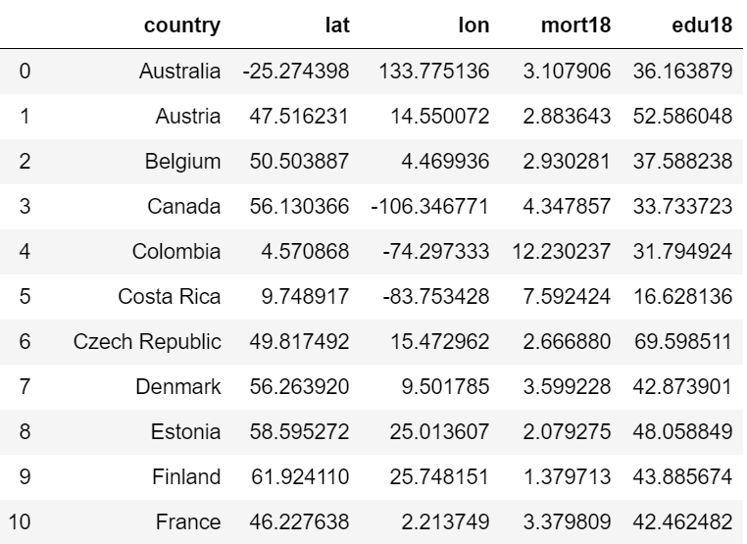
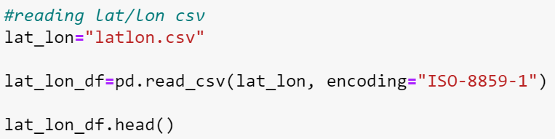
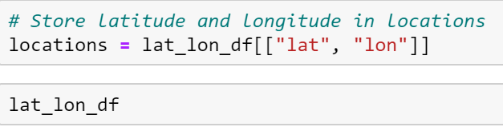
Reading CSV for Heatmap
Intro
Data Exploration
Data Cleanup
Data Analysis
Graphs
Conclusions
Create an excel with latitudes, longitudes and data for 2018 Infant Mortality and 2018 Education Data

Slide 19
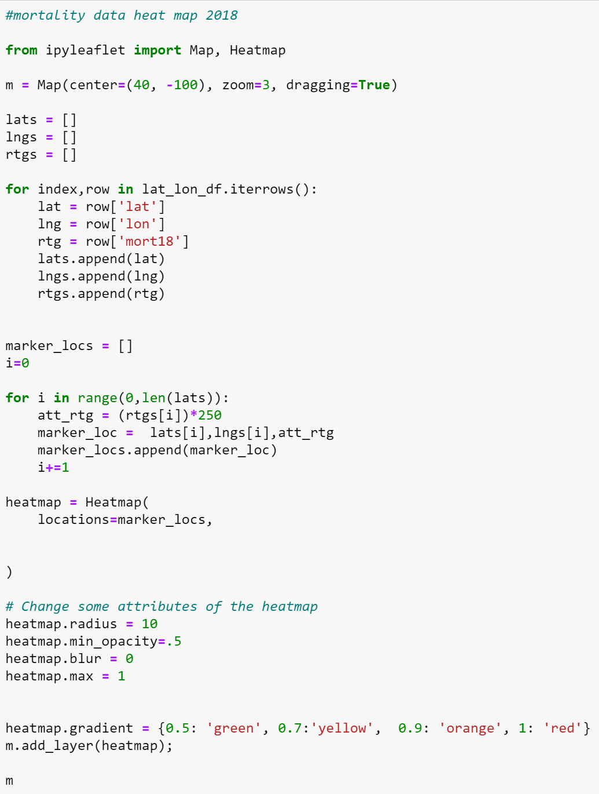
Heatmap for Infant Mortality Data 2018
Intro
Data Exploration
Data Cleanup
Data Analysis
Graphs
Conclusions
Import ipyleaflet for heatmap
Naming heatmap and giving certain map attributes, center, zoom, drag
Creating lists to store latitudes, longitudes, and ratings
Iterating through the rows to add to the empty lists
Creating an empty list for marker locations and setting i=0
Defining the intensity by multiplying the data by 250
Create a single list to store lats, longs, and data
Adding the information to the empty list
Increasing i by 1 to ensure it goes theough all the values
Heatmap is dependent on information from list
Adding attributes to heatmap
Adding gradient and printing map

Slide 20

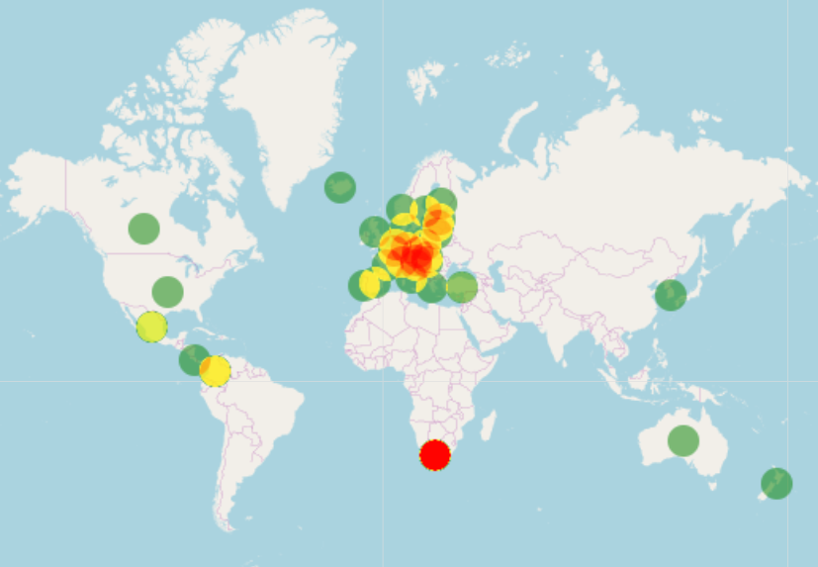
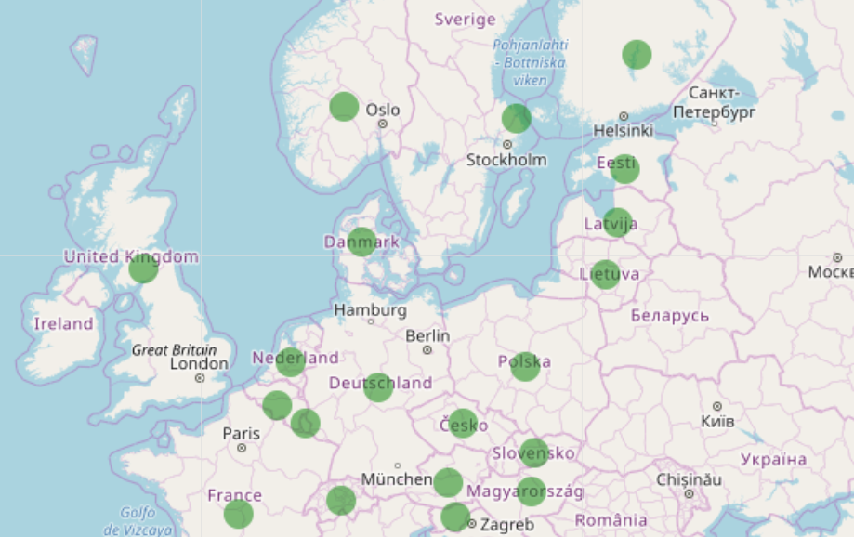
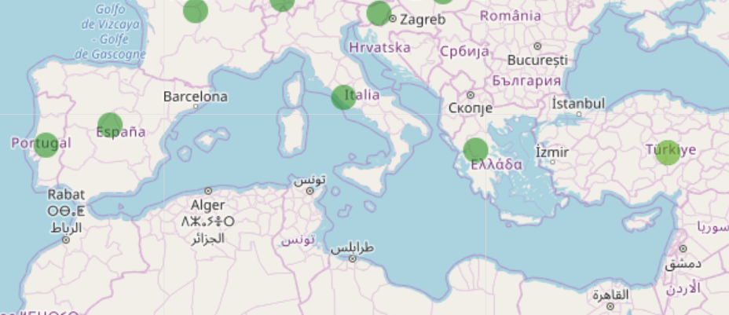
Heatmap for Infant Mortality Data 2018
Intro
Data Exploration
Data Cleanup
Data Analysis
Graphs
Conclusions
Less infant mortality
Most infant mortality

Slide 21
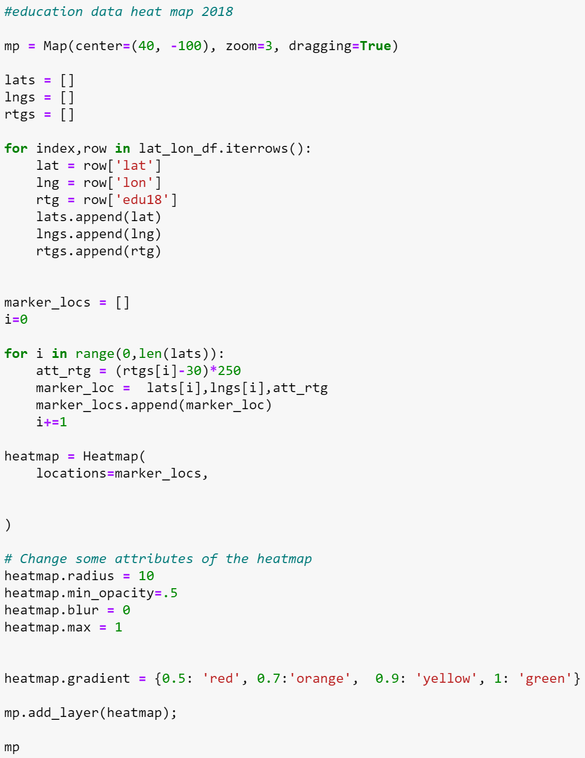
Heatmap for Education Data 2018
Intro
Data Exploration
Data Cleanup
Data Analysis
Graphs
Conclusions
Import ipyleaflet for heatmap
Naming heatmap and giving certain map attributes, center, zoom, drag
Creating lists to store latitudes, longitudes, and ratings
Iterating through the rows to add to the empty lists
Creating an empty list for marker locations and setting i=0
Defining the intensity by multiplying the data by 250
Create a single list to store lats, longs, and data
Adding the information to the empty list
Increasing i by 1 to ensure it goes theough all the values
Heatmap is dependent on information from list
Adding attributes to heatmap
Adding gradient and printing map

Slide 22
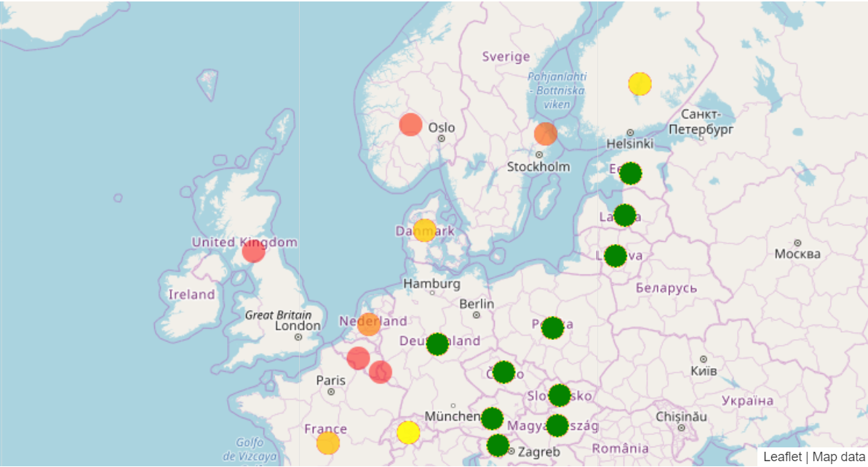
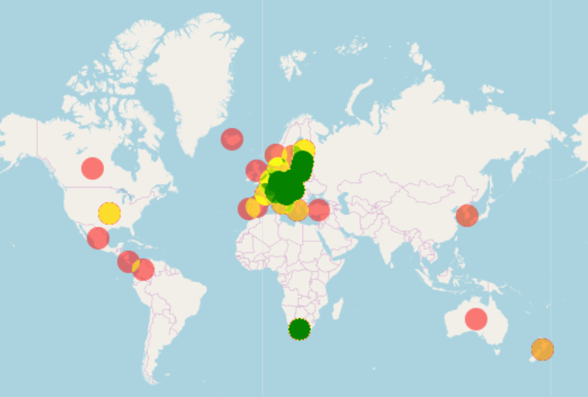
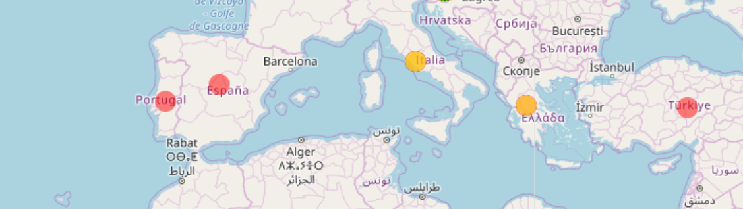
Heatmap for Education Data 2018
Intro
Data Exploration
Data Cleanup
Data Analysis
Graphs
Conclusions
Less educated
Most educated

Slide 23
Conclusions
Intro
Data Exploration
Data Cleanup
Data Analysis
Graphs
Conclusions
Our data shows that there is no correlation between Education Rates in adults and Infant Mortality Rates from 2014 – 2018
This is what we deduced from the information we gathered, but this may not be representative of the bigger picture
In future analysis we would:
Search for other sources that provide more information
Use a larger timeline (i.e. Analyze data from 1900-2010 in 10-year intervals)
Use population information to create a bubble chart
See if the data is correlated and use a linear regression
Analyze other levels of education in adult populations

